Slide 1
Java + Web Development Course code: DLBCSPJWD01 Matriculation #: 92122307 Professor: Christian Remfert Github link: https://github.com/belsh17/StokvelUpdates.git

Slide 2
Agenda
Purpose of web application
Architecture diagram
Technology Choices
Screenshots of web application
Chart of changes
Screen cast
Key: TC = Test Case

Slide 3
Purpose of web application
The livestock market consists of different animals that a user can purchase without having to go to a live auction.
This is more efficient for people with busy schedules
The user will scroll through the variety of animals, if the user wants to add an animal to their cart, they will need to create an account, login or continue as a guest.
The business will reserve the animal purchased for the user and notify them when the animal will be ready for delivery/collection.
The target user group is different religious groups (Islamic, Hindu etc.), different cultural groups (Zulu, Portuguese, Sesotho etc.), people hosting functions/venues (weddings, funerals, parties etc.), smaller livestock vendors.
This application is for users to choose an animal in which they will prepare for their traditional meals at home or at family functions. The benefit of this application is that users from different religious groups and cultures will be ensured that their animal that they are receiving will be prepared according to their beliefs.

Slide 4
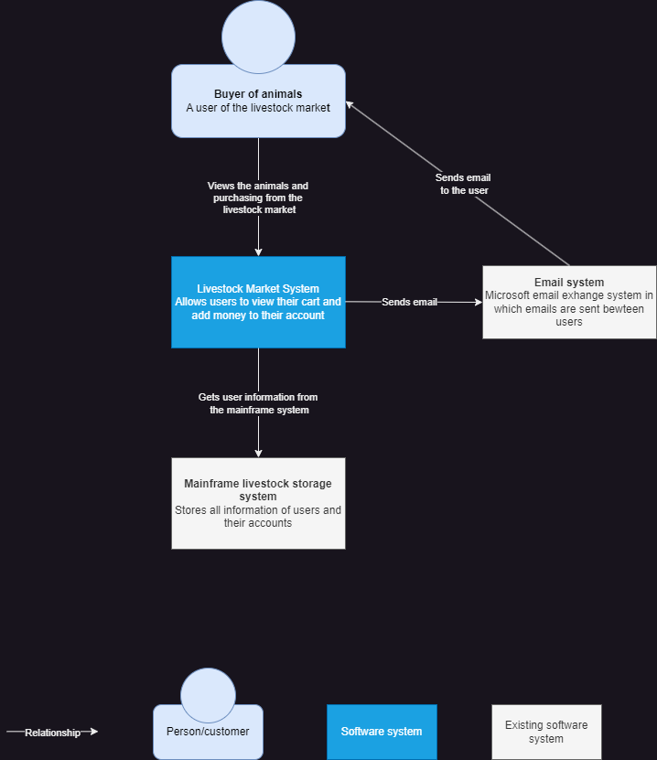
Architecture Diagram

Slide 5
Technology Choices
Front end:
HTML (VS code)
CSS (VS code)
JavaScript (VS code)
Back end:
MySQL Database
Node.js (server)

Slide 6
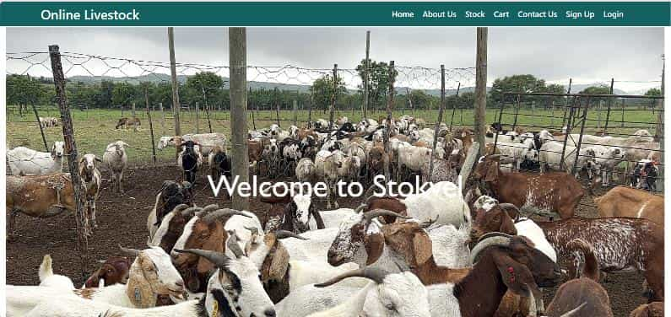
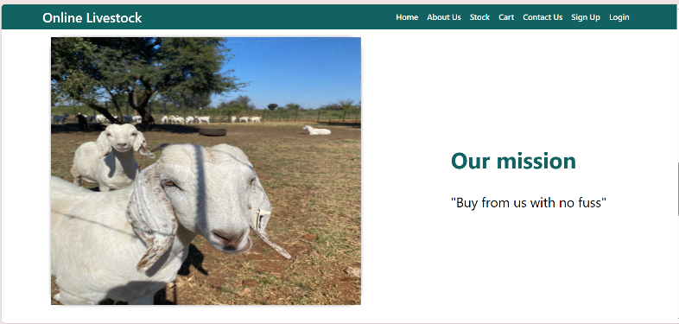
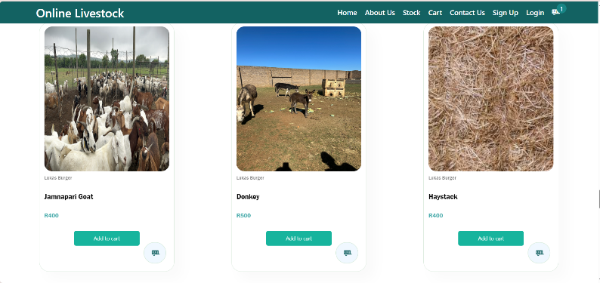
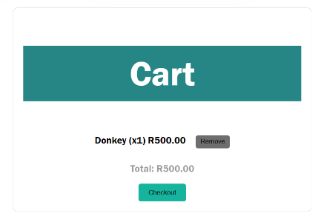
Screenshots of web app.
1.
2.
Picture 1. Is the opening page showing the home screen.
Picture 2. displays a flip tile on the ‘about us’ page which when hovered over displays the text describing the mission of the company.
Picture 3. displays the stock available to add to the user's cart. TC: ‘Add to cart” button is clicked > cart in top right hand corner updates and cart (#4) stores the information.
Picture 4. displays what the user has added. TC: Button “Checkout “ is clicked > directs to checkout page displayed on slide 8
3.
4.

Slide 7
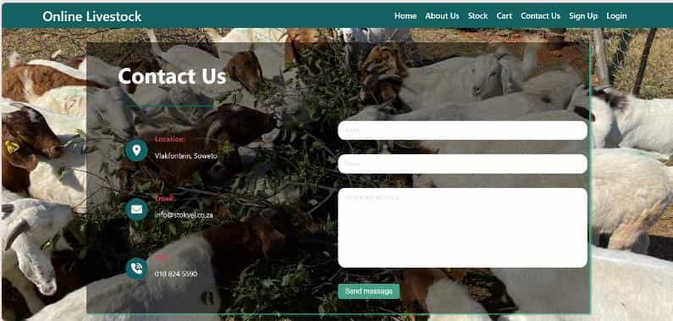
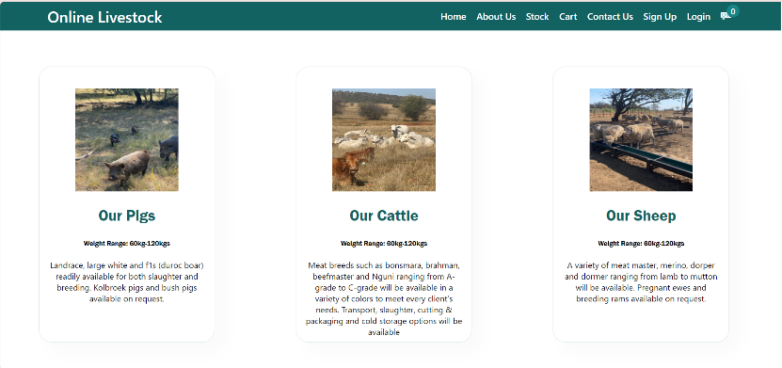
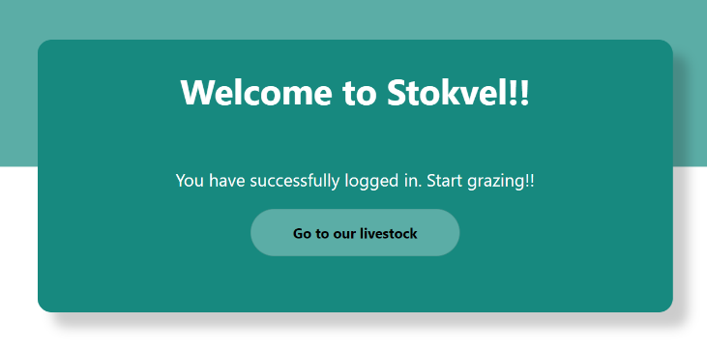
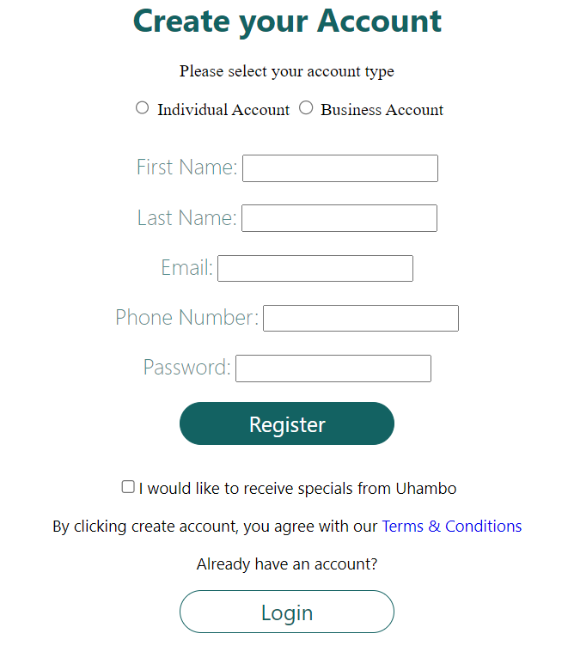
Screenshots of web app.
1.
2.
Picture 1. is the contact us page displaying how the user can reach the company.
Picture 2. displays the categories of the stock available in which the user can choose which animal they are looking for specifically.
Picture 3. displays the welcome screen after the user has successfully logged/signed in. TC: Button “Register” is clicked > and screen (#3) is displayed
Picture 4. is the sign-up page which the user fills out and it will be stored in a database
3.
4.

Slide 8
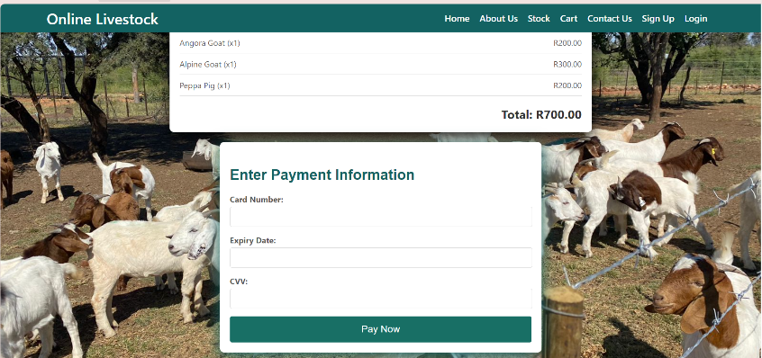
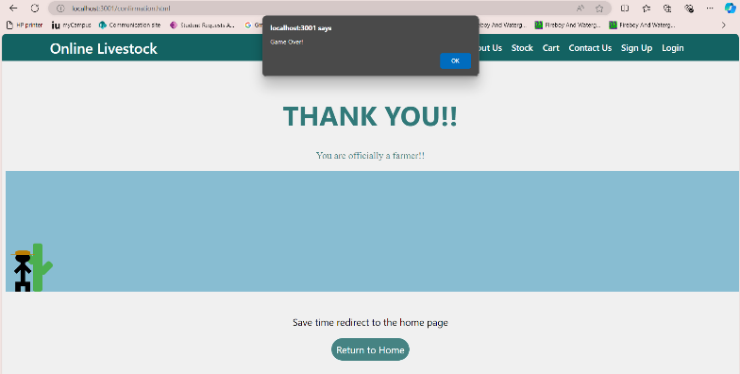
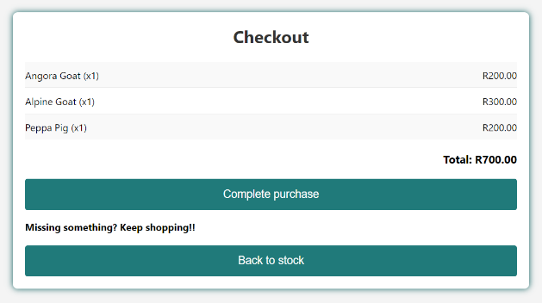
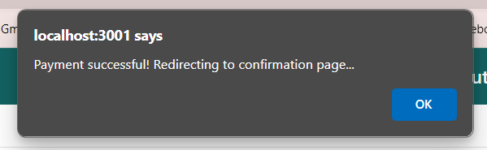
Screenshots of web app.
1.
2.
Picture 1. displays the payment page in which the user will enter their card details to make payment for their purchase.
Picture 2. displays the page after payment has been made and the order has been accepted. The stickman and cactus is a mini game that the user can play after shopping. The stick man jumps over the cactus else the user can return to the home page. TC: “Return to Home” is clicked > redirects to page on slide 6 screenshot 1
Picture 3. displays the checkout box which shows the user what they will be purchasing. TC: Button :Complete Purchase” is clicked > Redirected to payment page (number 1.)
Picture 4. TC: Button “Pay now” is clicked > displays a popup message block which informs the user that their payment was successful, and it will now redirect them to the checkout screen. (number 3.)
3.
4.

Slide 9
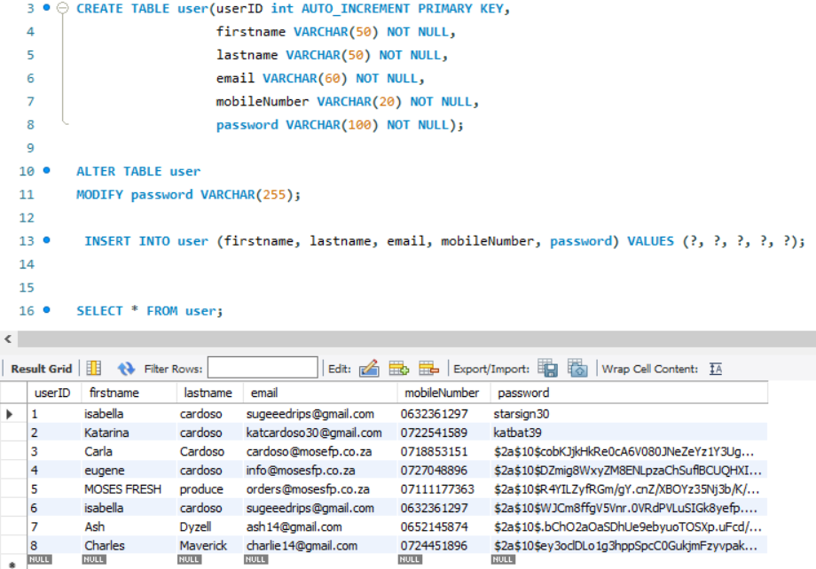
Additions from phase 1 to phase 2
I did not change the technology choices from Phase 1 to phase 2. Instead of changes from phase 1 I just made some additions.
In phase 1 I said passwords will be securely stored but I did not mention how. In phase 2 I used “bcrypt” to hash passwords when stored in the database.
The screenshot shows an example of how the user’s details are stored in MySQL. In which the password has been encrypted. This is to improve security of the user’s personal details.
I also added a mini game once the user has made payment. This just adds some uniqueness to the website.

Slide 10
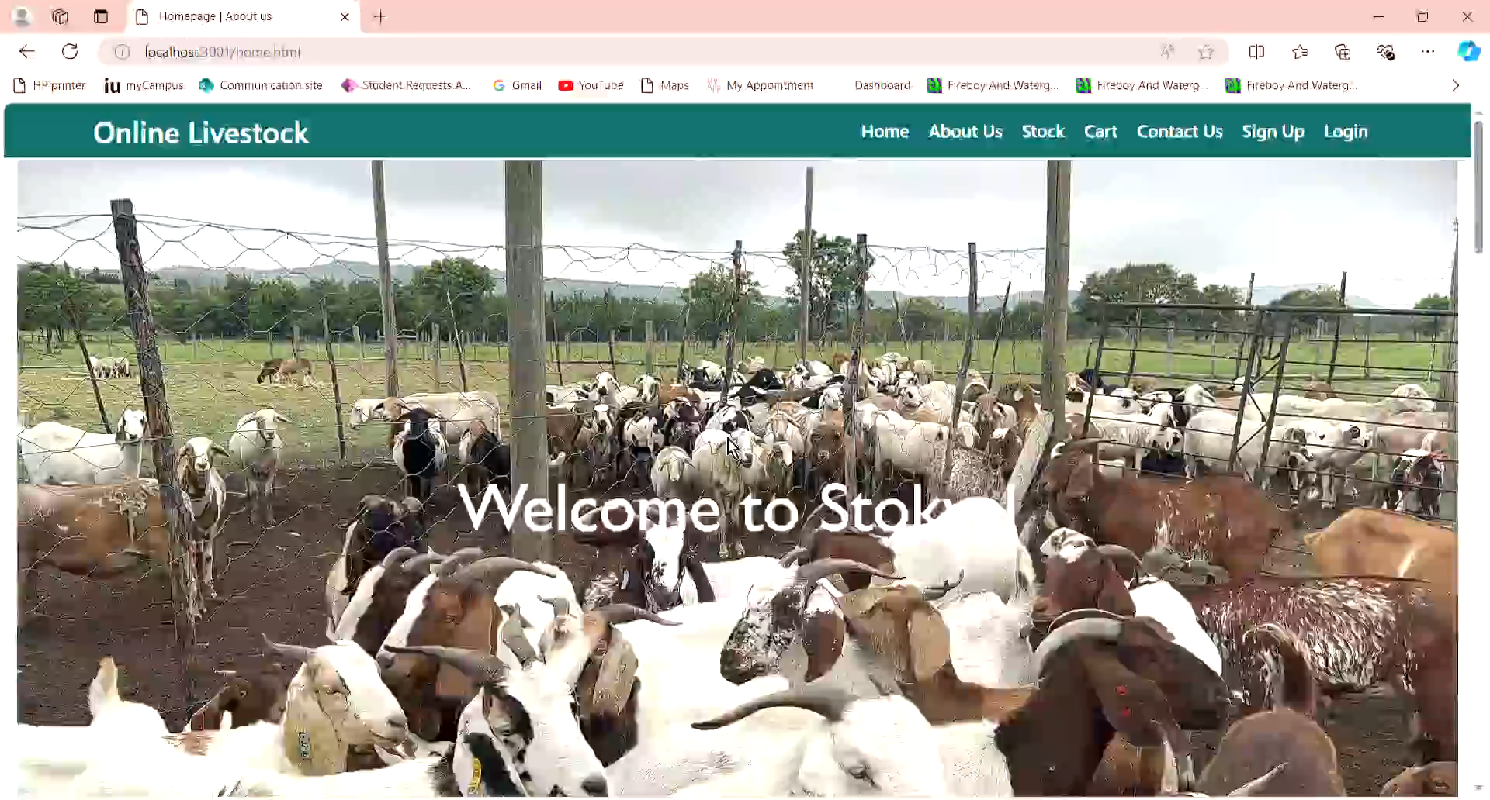
Screencast video

